Slide 1
White box testing:(of cus_order.php code)
This is white box testing of customer order process .
The code on which white box testing is tested is cus_order.php
For whitebox testing all lines of the code is not used
So, for which portion of the code is used the snippet is given in the next slide

Slide 2
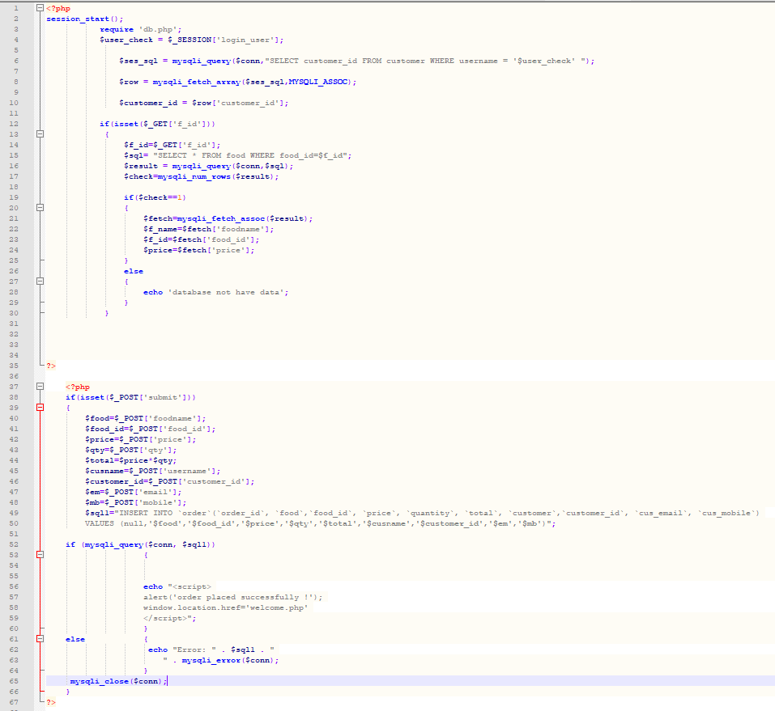
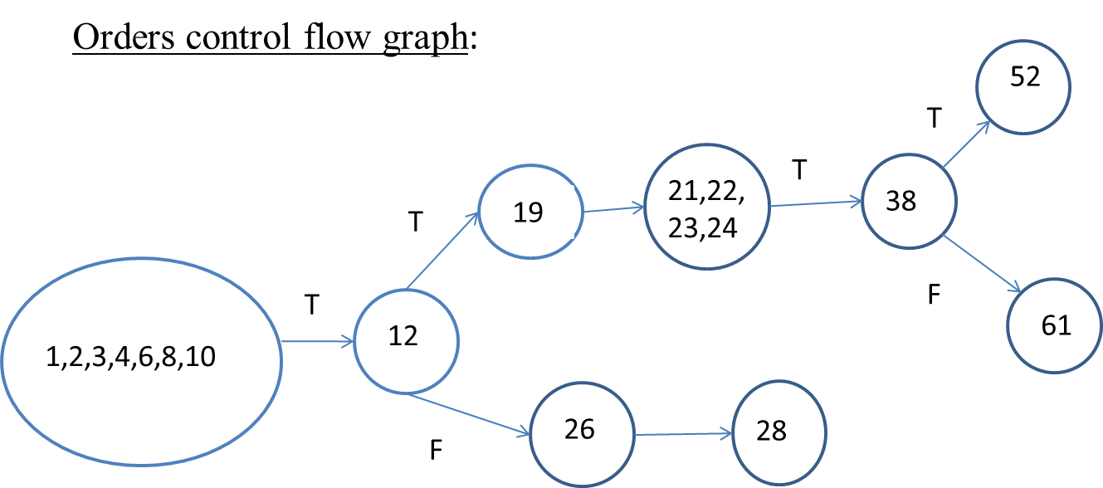
White box testing:

Slide 3
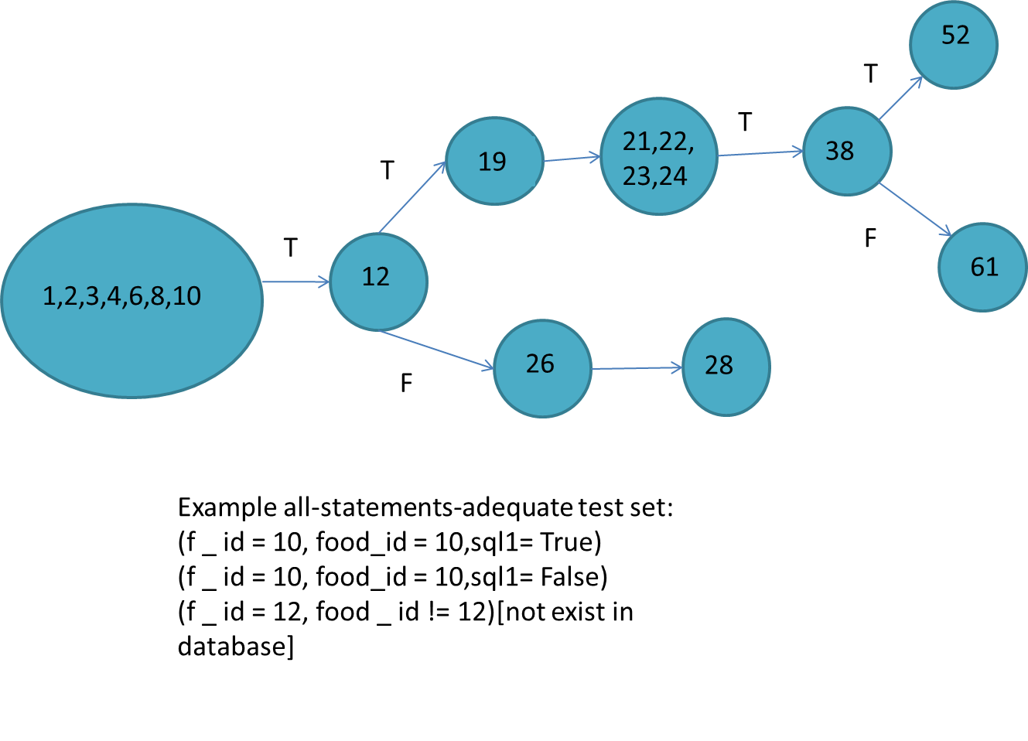
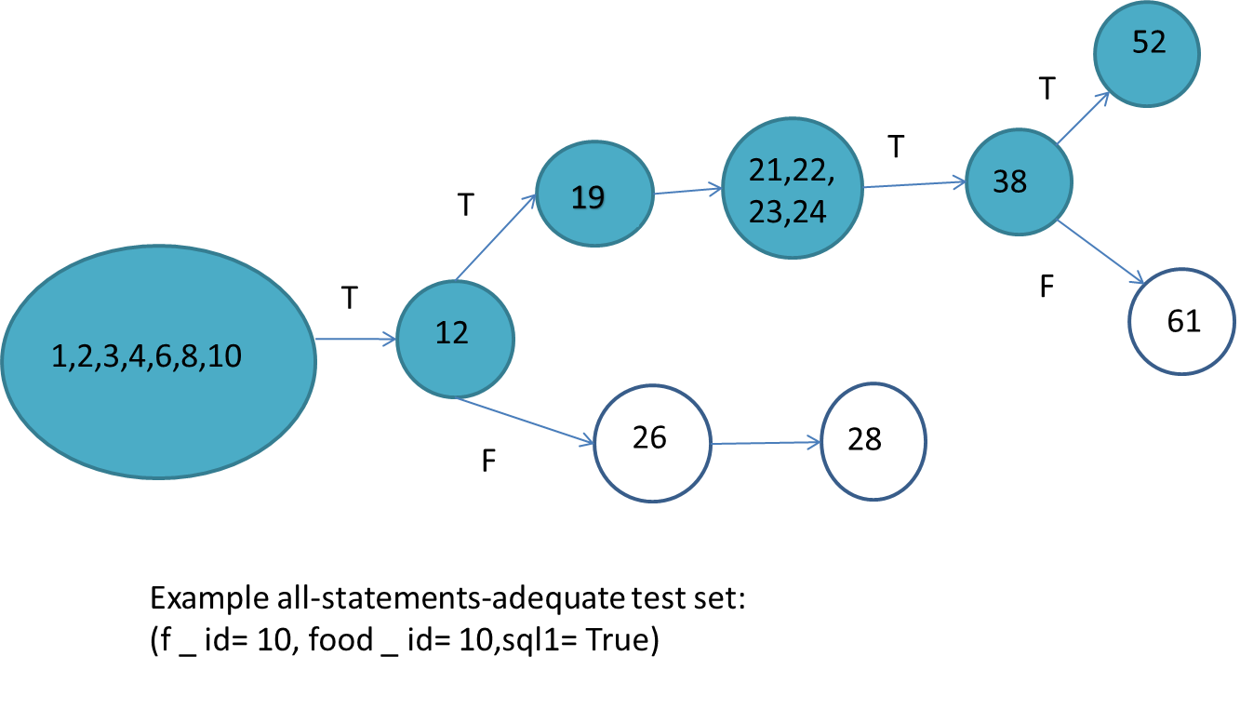
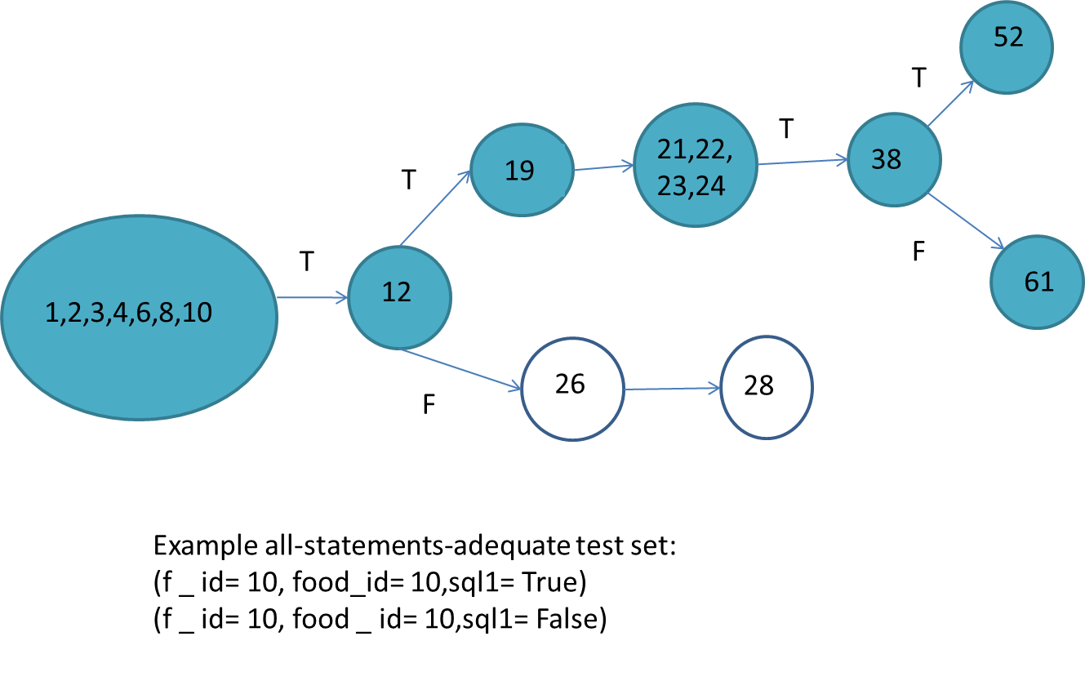
All statements coverage of order:

Slide 4
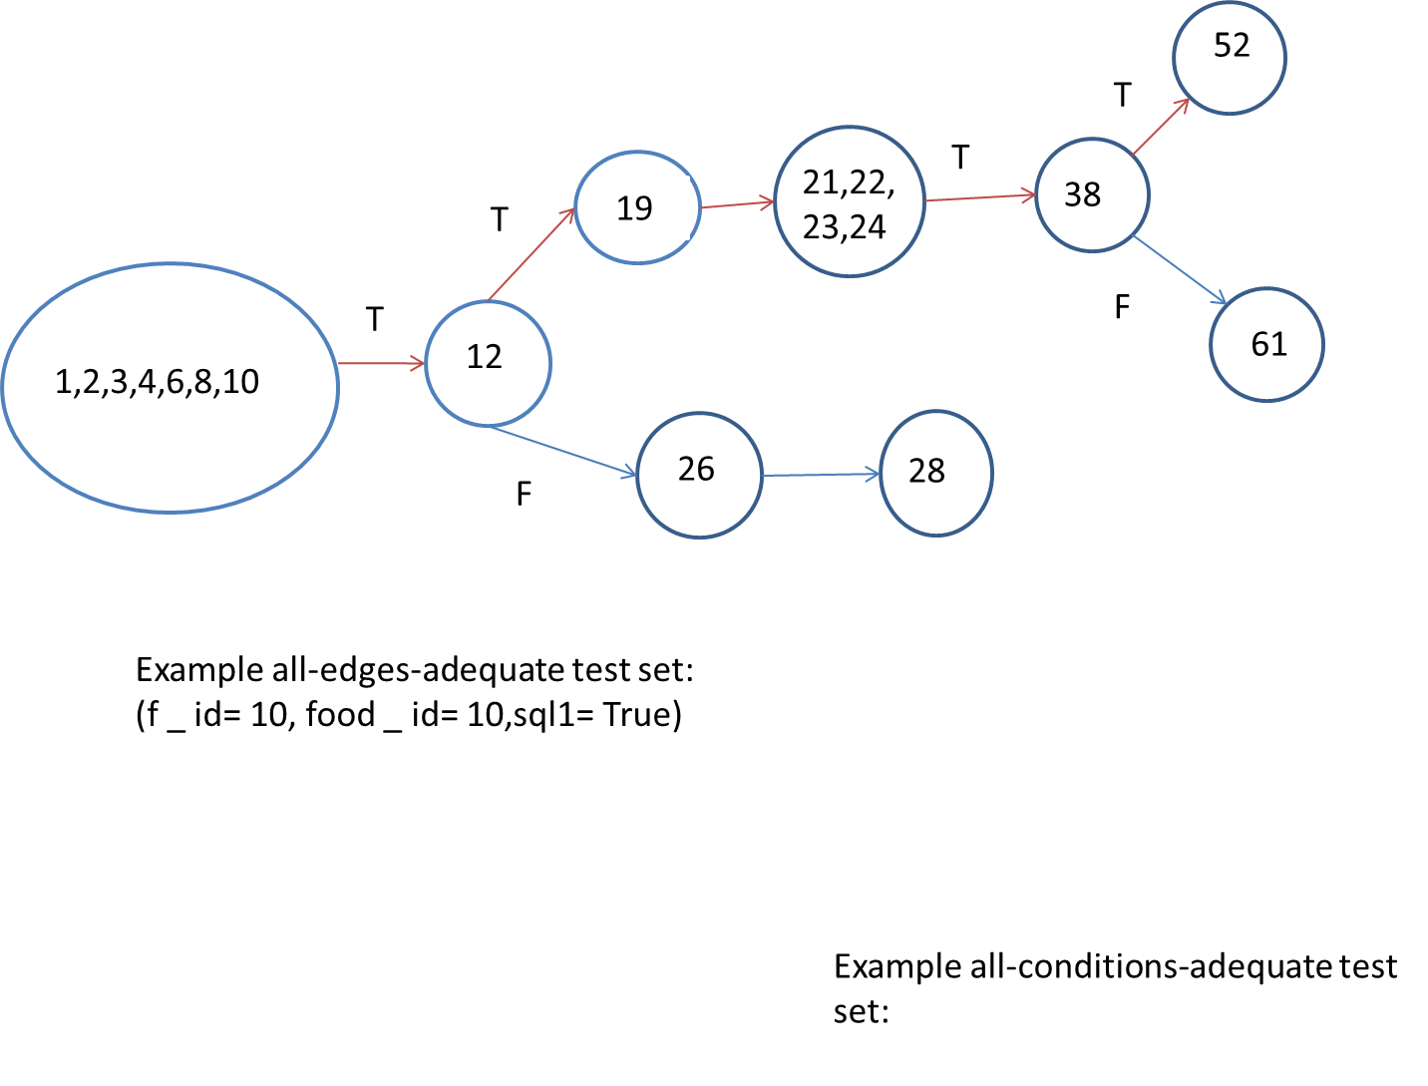
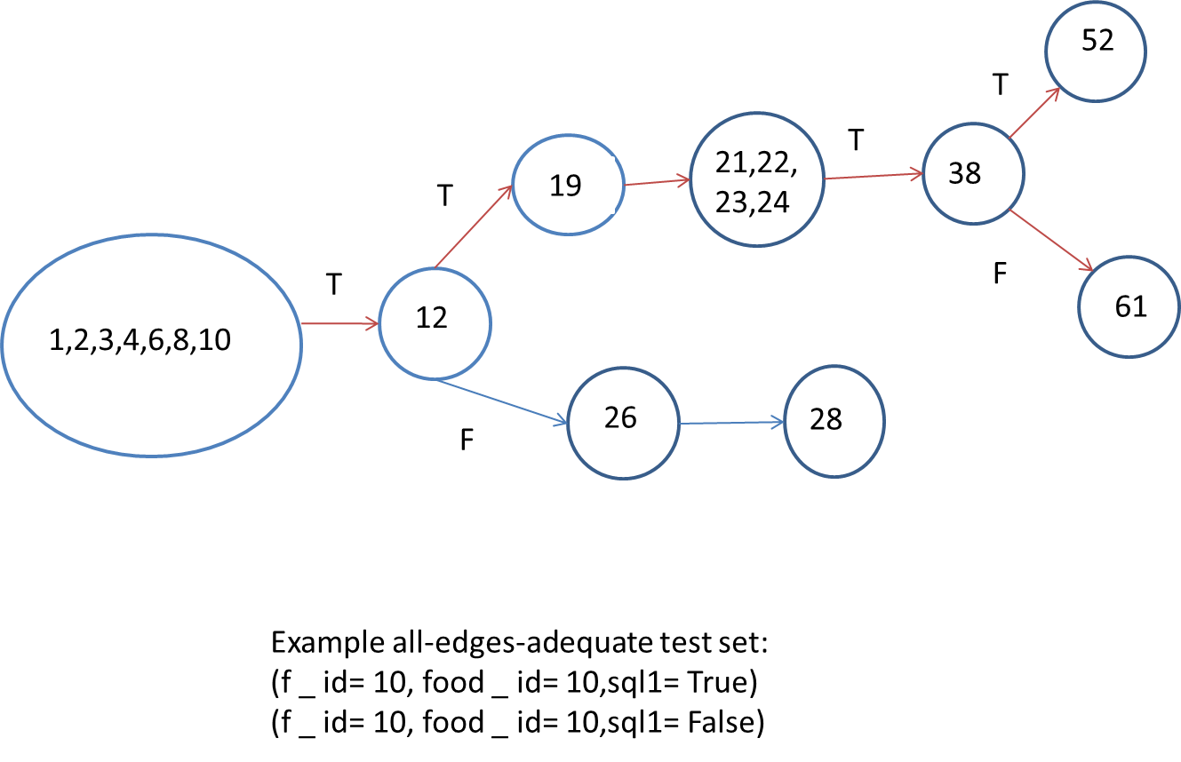
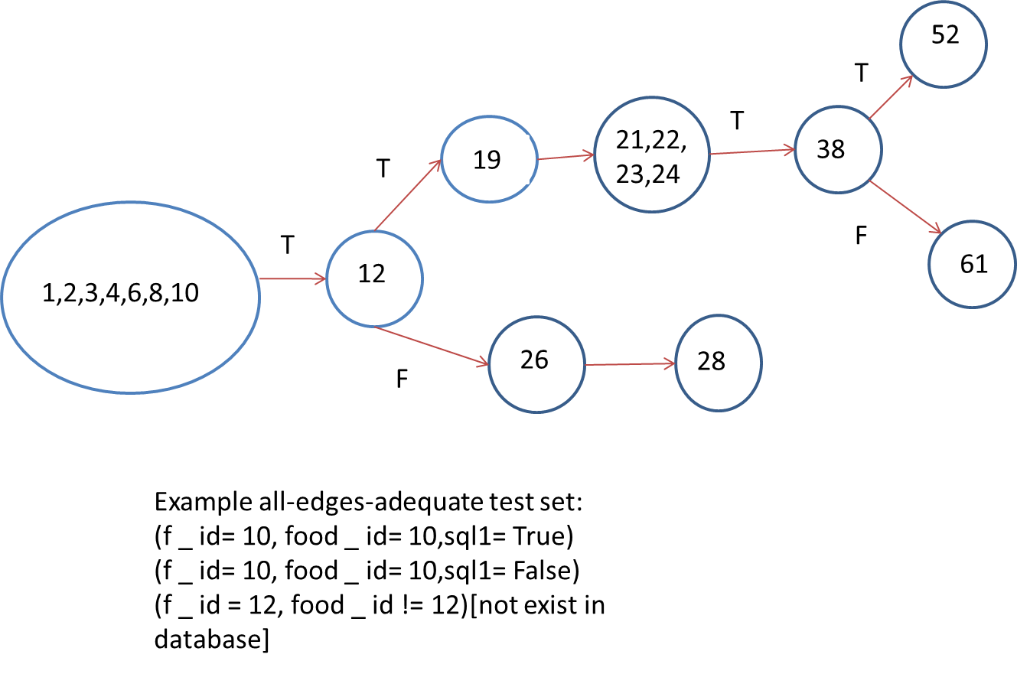
All edge coverage of order:

Slide 5
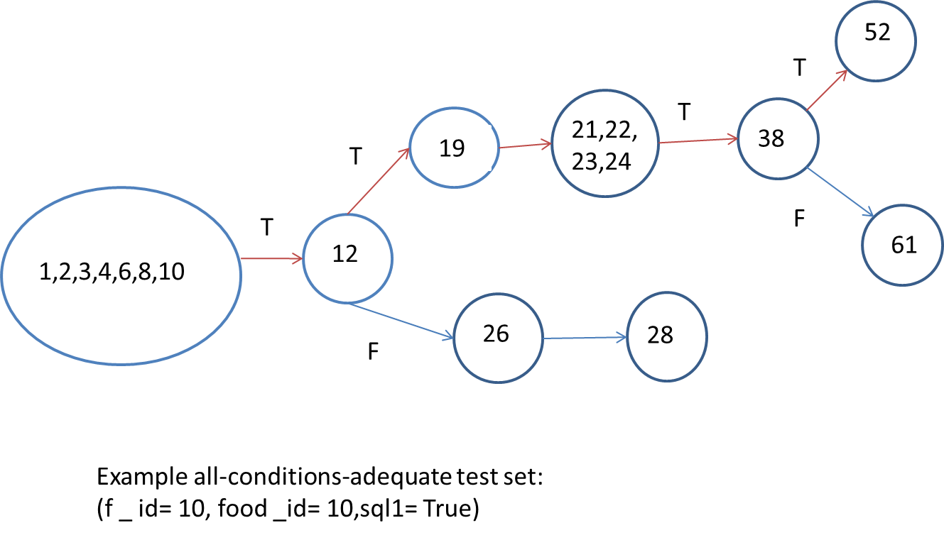
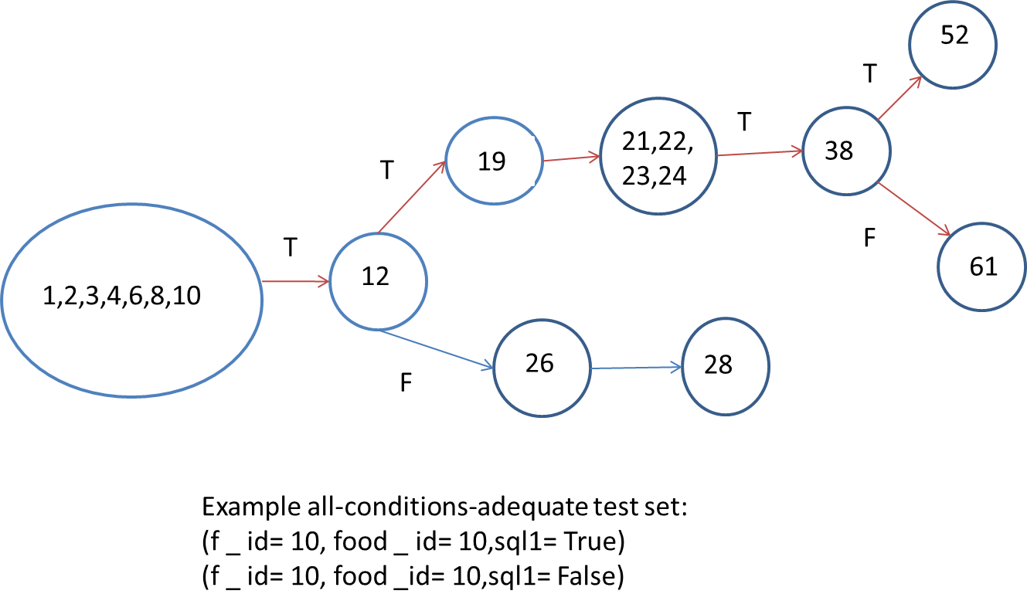
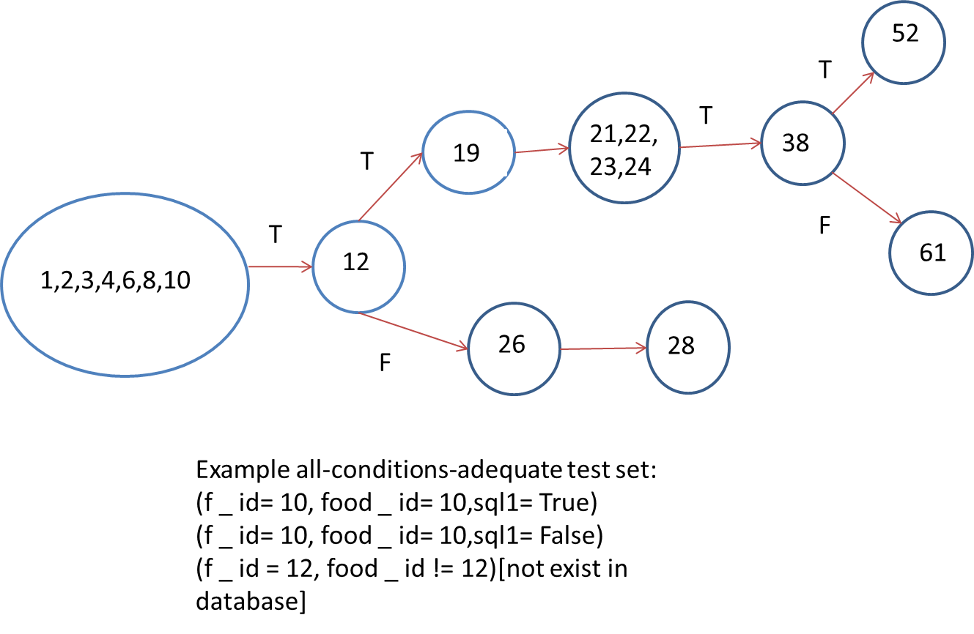
All condition coverage of order:

Slide 6



All path coverage of order:

